Slide 1

Satellite Image Analysis with DVC
Presented By: Nayana Nagarajappa
Class: Math 608 Data Science for Grad studies

Slide 2

AGENDA
Project Overview
What is DVC
Project Workflow
Key benefits
Q & A

Slide 3
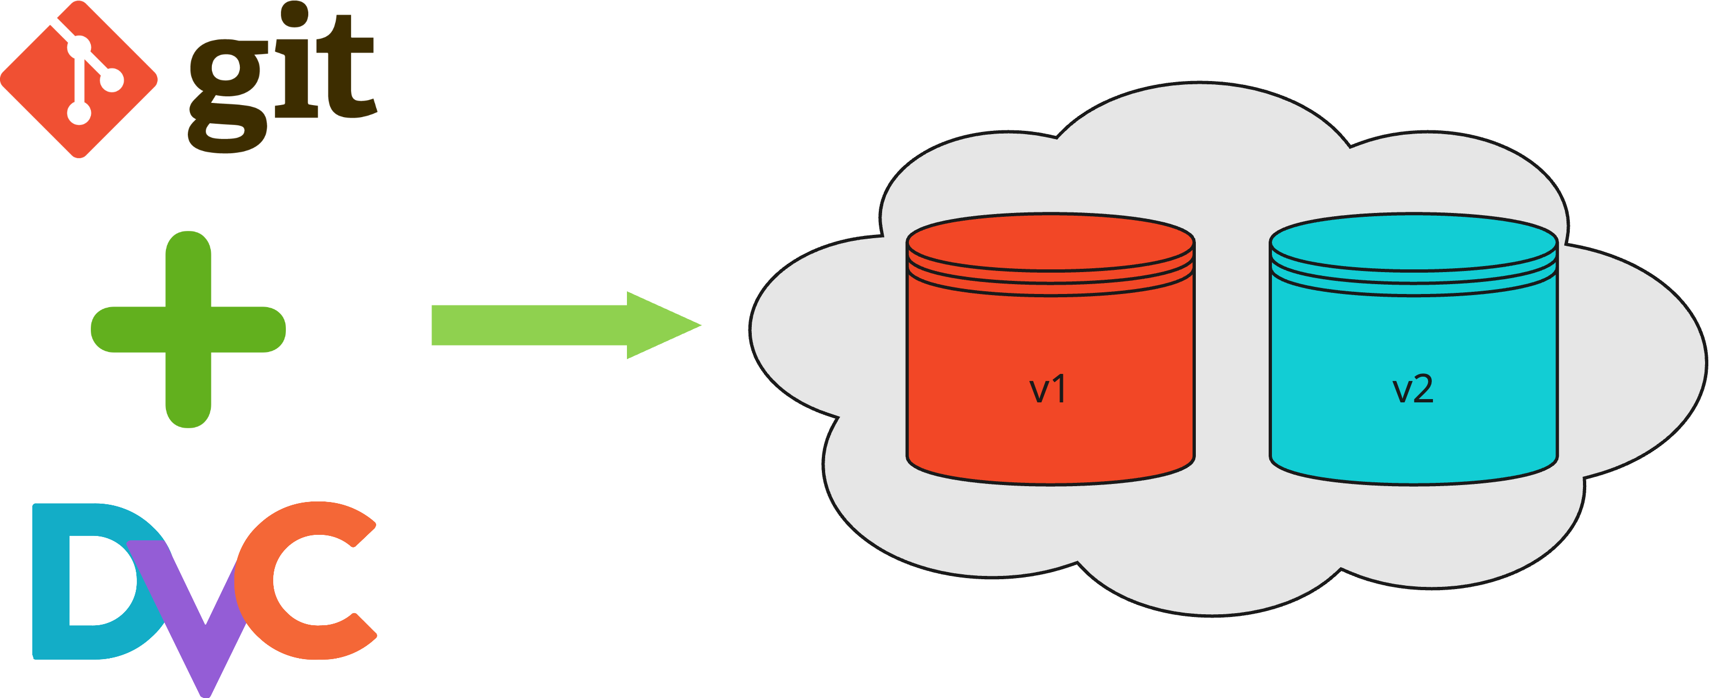
“DVC is an open-source tool for versioning, managing, and collaborating on large datasets and machine learning models.”
Data Version control?

Slide 4
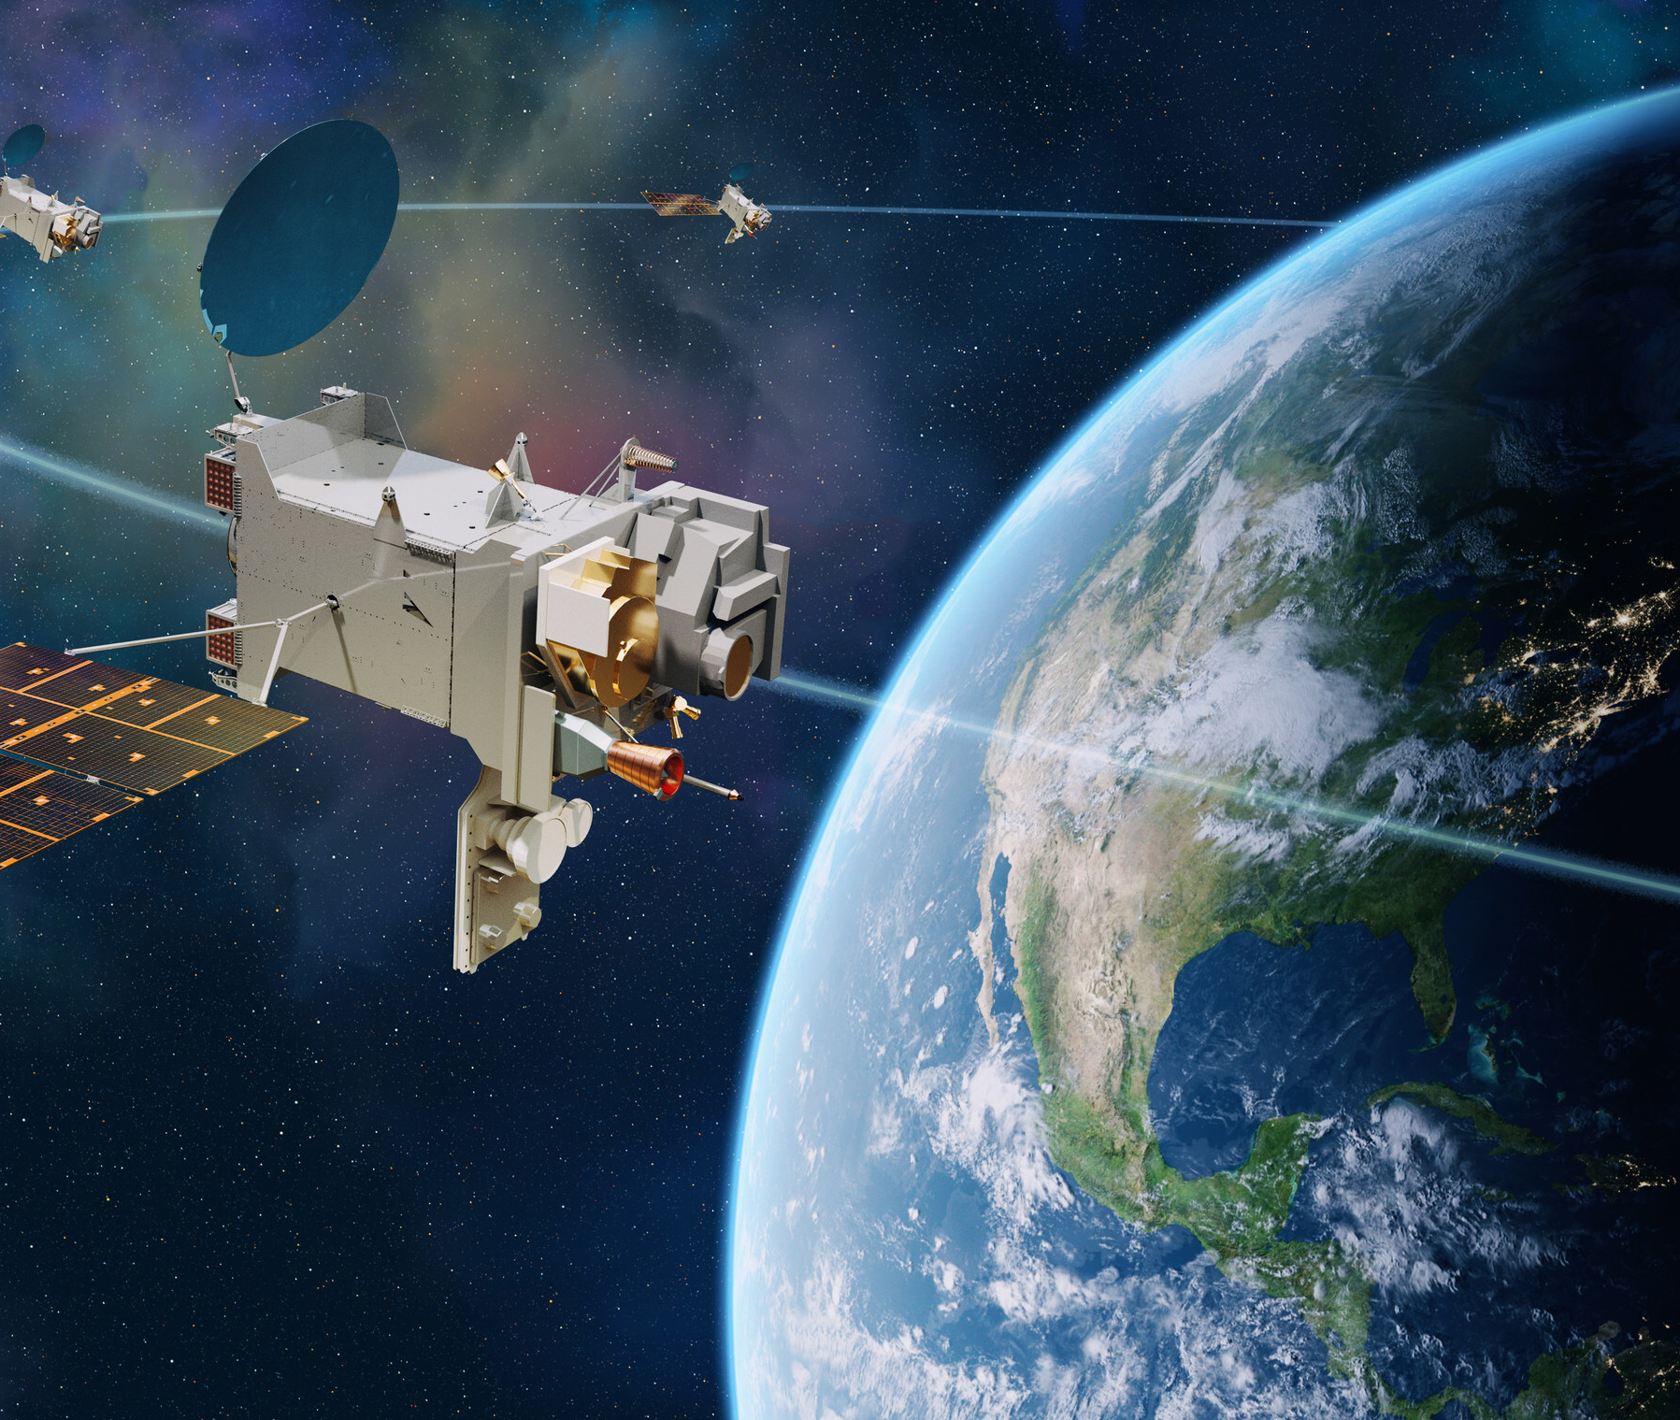
Project Workflow
Step 1: Pulling Satellite Images
Objective: Automate the process of downloading satellite images.
How:
Developed a Python script that pulls satellite images from free sources like NASA
Script filters images based on location, date range, or cloud cover.
The images are retrieved using a REST API at scheduled intervals, managed through a Cron expression for automation.

Slide 5
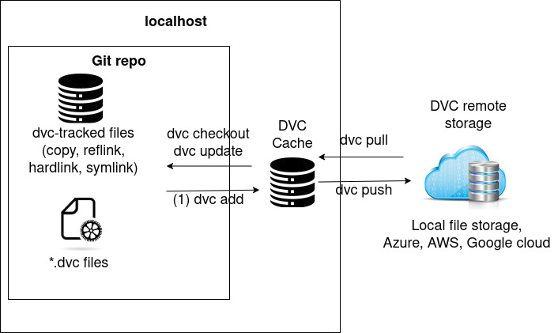
Project Workflow
Step 2: Managing Datasets with DVC
Initialization:
DVC is initialized in the project directory using dvc init.
This sets up the DVC environment and creates the necessary .dvc files and configurations.
Adding and Tracking Images:
The satellite images (e.g., stored in a data/images/ folder) are tracked using the dvc add command. This creates a .dvc file (e.g., data/images.dvc), which acts as metadata for the tracked files.
The large files are not committed to Git. Instead, DVC stores their versioned metadata, while the actual files are pushed to remote storage (e.g., GCP).
Reproducibility:
By committing the .dvc files to Git, the dataset versions are locked in the repository.
Anyone can reproduce the same version of the dataset using: dvc pull
This ensures that all team members or environments can access identical datasets.

Slide 6

Project Workflow
Step 3: Storing Data in GCP Cloud Storage
Objective: Efficiently store and retrieve large datasets
How:
Configured GCP Cloud Storage as the DVC remote.
Linked DVC to GCP using authentication credentials.
Key Steps:
dvc remote add -d gcpremote gs://bucket-name
DVC handles data synchronization between the local project and GCP Cloud Storage.

Slide 7
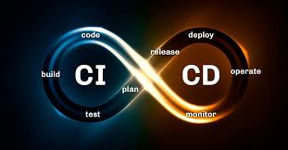
Project Workflow
Step 4: Automation with GitHub Actions
Objective: Automate the end-to-end workflow (image pull → version → push).
How:
Set up GitHub Actions to trigger:
Python script execution to pull new images.
DVC commands (add, commit, push) to manage and store updated data.

Slide 8

Key Benefits
Improved version control for large datasets.
Streamlined data storage and retrieval.
End-to-end automation reduces manual effort.

Slide 9

Q&A THANK YOU

